Slide 1
A3.1.1 Relational Databases: An Overview
Learning Objective: To explain the features, benefits, and limitations of a relational database.

Slide 2
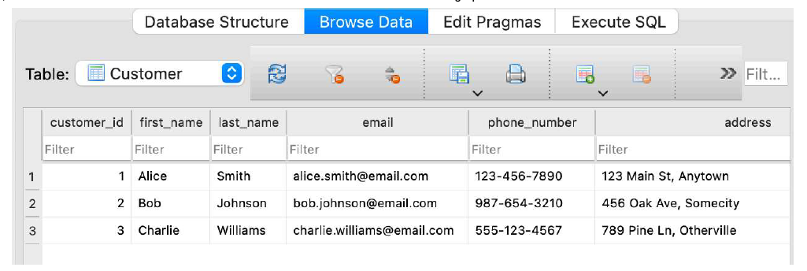
Starter Activity (3-5 minutes)
Identify the primary key , Records and Fields from the given data table

Slide 3
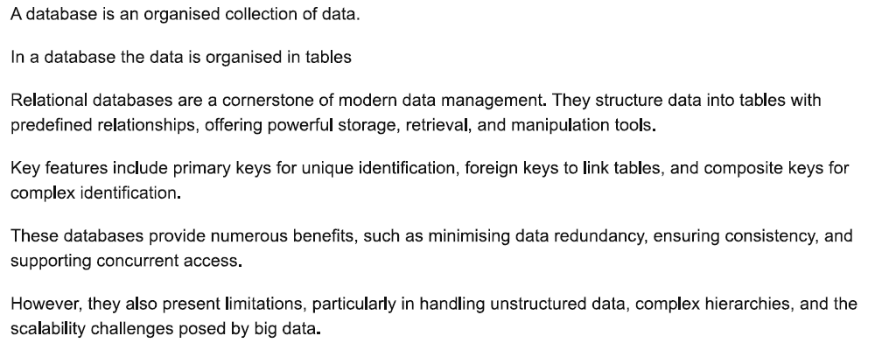
Relational Database

Slide 4
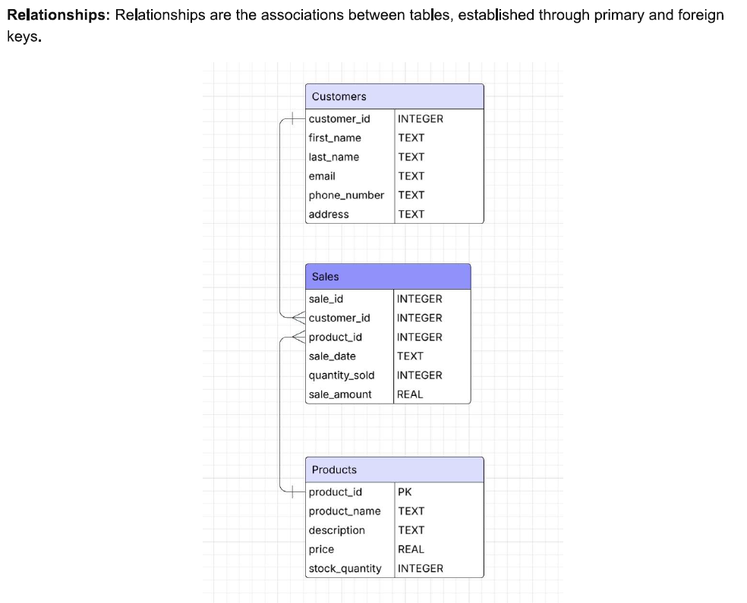
Key Features of Relational Databases

Slide 5
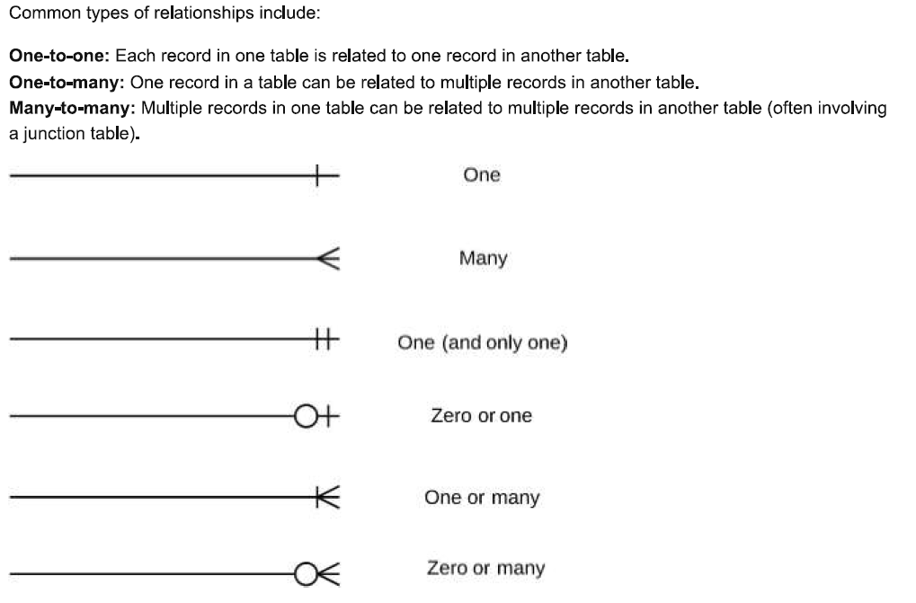

Slide 6
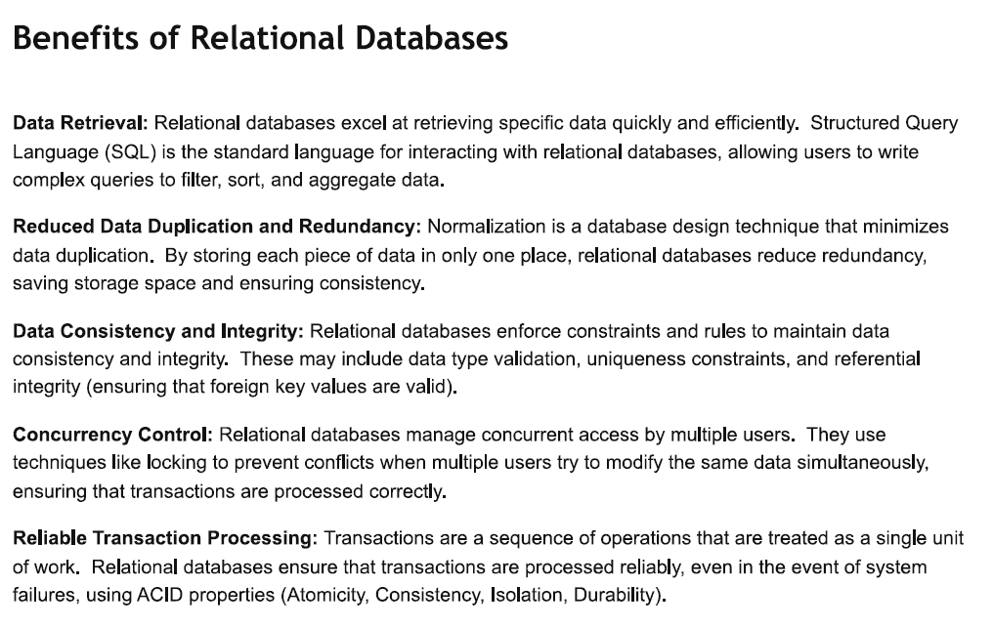

Slide 7
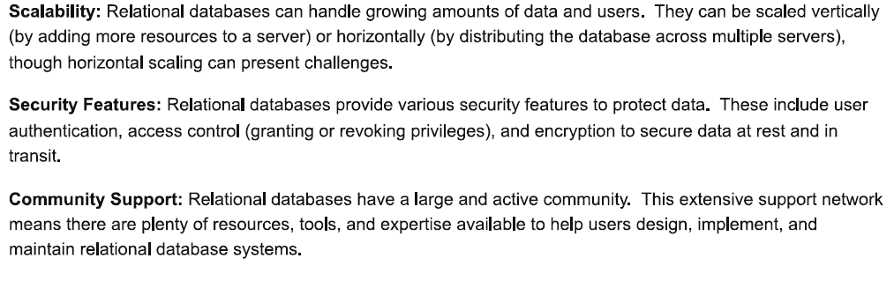

Slide 8
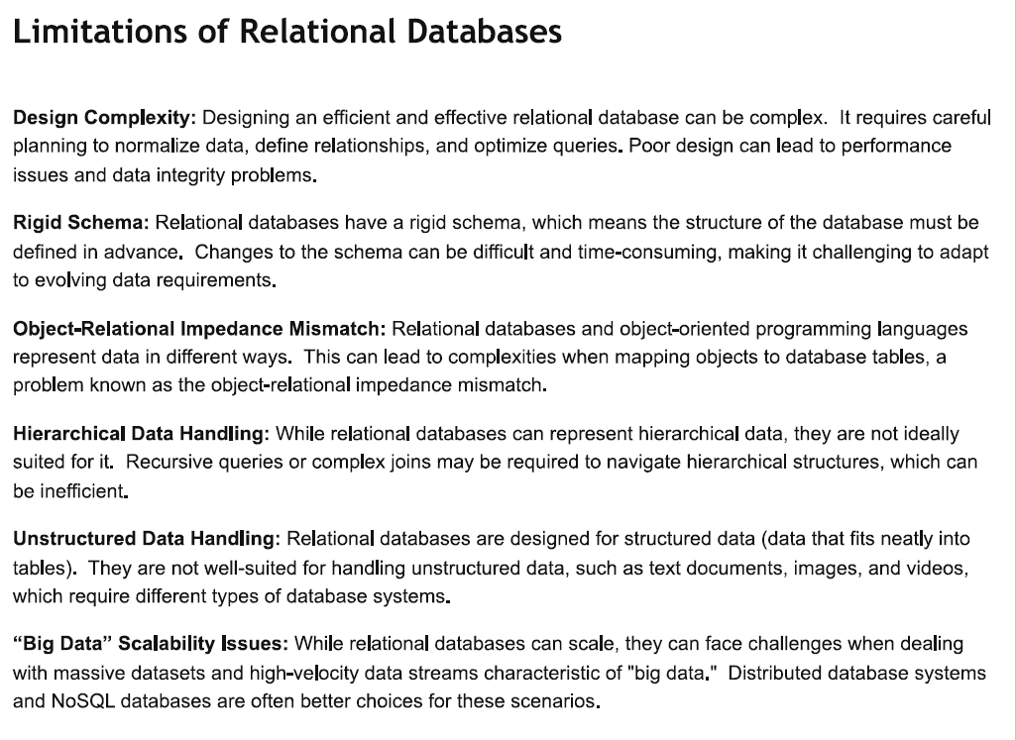

Slide 9
Question 1 – Features
A school is storing student information in a spreadsheet. Each time a student joins a club, their details are copied again into a new sheet. This has led to inconsistent spellings of names and incorrect addresses.
a. Explain how the features of a relational database could solve this problem.
b. Identify one entity and its attributes that could be used in this database.
Question 2 – Benefits
A hospital is moving from a filing cabinet system to a relational database. The management is worried about staff being able to quickly access patient records.
a. Describe one benefit of using a relational database in this scenario.
b. Explain how relationships between tables would improve the accuracy of patient information.
Question 3 – Limitations
A small business with limited IT staff is considering adopting a relational database to manage customer orders and payments.
a. Explain one limitation of using a relational database in this context.
b. Suggest an alternative solution and justify why it might be more suitable.

Slide 10
Plenary
QUIZ Activity -Printout provided

